Slide 1
JavaScript Basic Concepts
Shafi

Slide 2
Objects
Primitives vs Objects
Wrapper Objects
When accessing the properties directly on any primitive value, JavaScript internally type coerce it into its Wrapper object and later remove the object.
var temp = new Number(num); temp.toString()

Slide 3
Constructor Function
Constructor function is away to create the blue print for objects(OOP), we can create instances of this type by using the new keyword with Constructor.

Slide 4
Inheritance in JavaScript
JavaScript is a prototype based language.
Inheritance is Achieved through the prototype feature.
Every JavaScript object has a prototype property, which make the inheritance possible.
prototype property is where we put the methods and properties that we want other objects to inherit.
Prototype Chain: when a certain property/method is called, the search starts from the current object itself, if not found, then search in it's prototype, if still not found search in it's prototype and so on until reaches the object, if not found even on Object return undefined.

Slide 5
prototype vs _proto_
proto is the actual object that is used in the lookup chain to resolve methods.
prototype is the object that is used to build proto when you create an object with new.

Slide 6
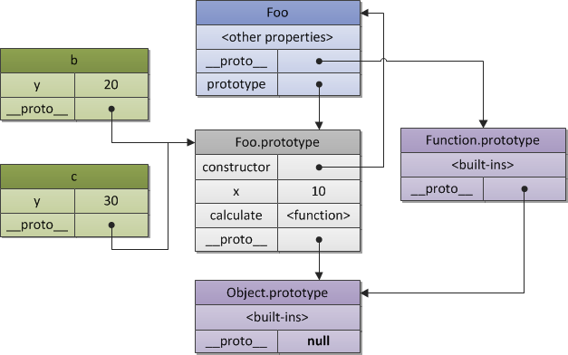
Prototype deep dive

